Slide 1


CSS Path- Introduction
By –Shrish Tripathi

Slide 2


Slide 4


Slide 5


Slide 6


Slide 7


Slide 8


Slide 9
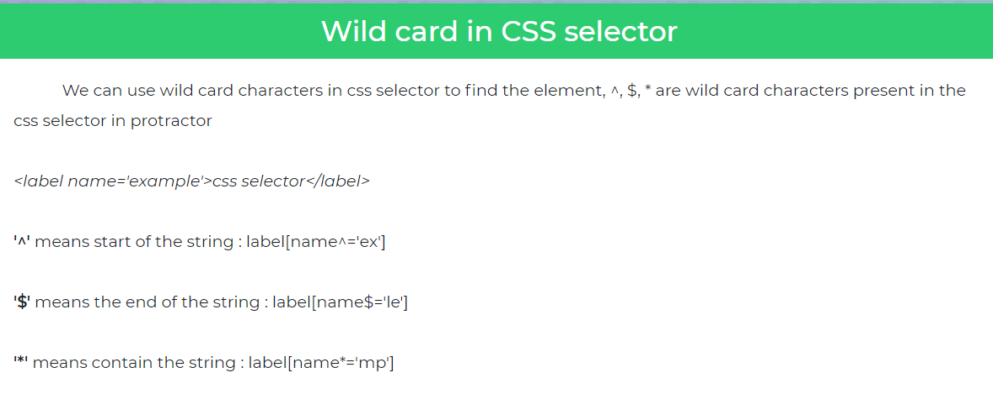

Slide 10


Slide 11
Css cheat Sheet

Slide 12
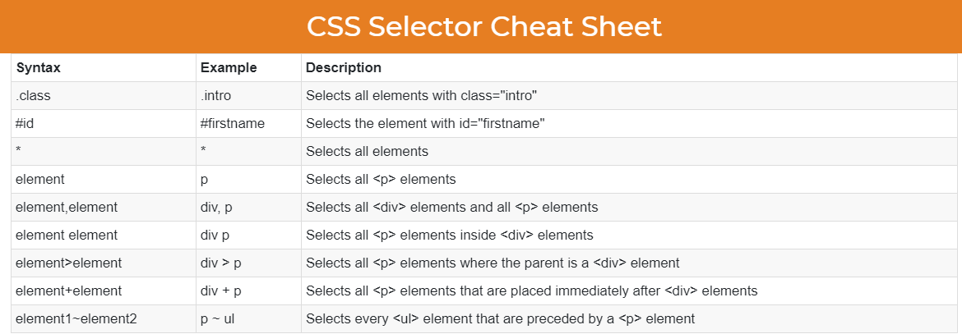

Slide 13


Slide 14
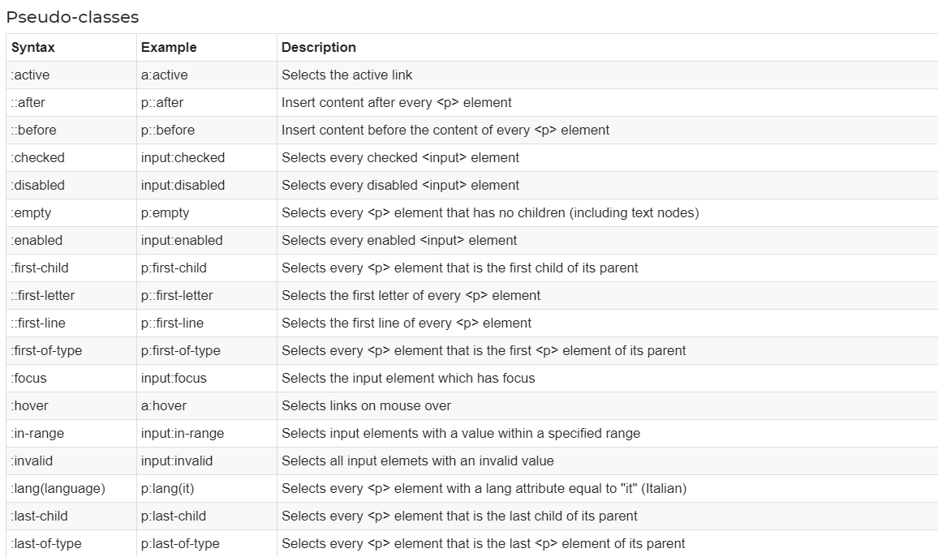

Slide 15
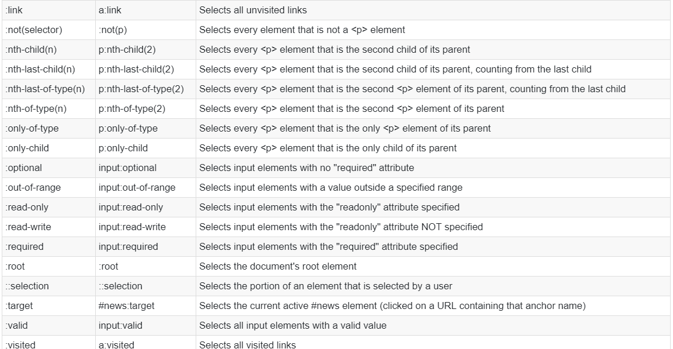

Slide 16
Thanks

